Slide 1
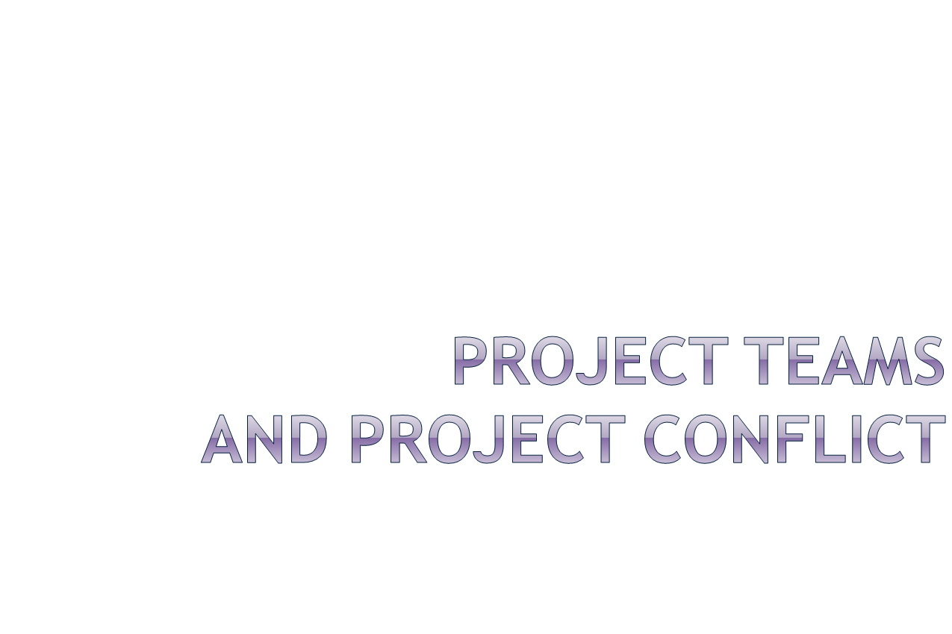

Slide 2

At what point is the project team formed?
Who should select the project team?
What types of people should be on the team?
How do the team members get started?
Part 3 - Project Teams & Conflict

Slide 3
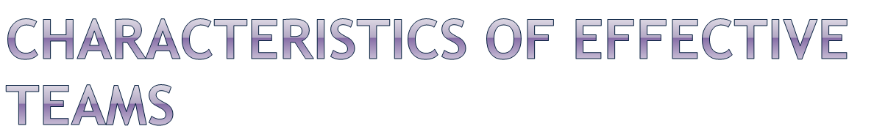
An effective project team has:
A clear understanding of the project objective
Clear expectations of each person’s role and responsibilities
A results orientation
A high degree of cooperation and collaboration
An atmosphere of open communication
A high level of trust
Part 3 - Project Teams & Conflict
Notes:
Efficient (adj.) – Performing or functioning in the best possible manner with the least waste of time and effort. The difference between effectiveness and efficiency can be summed up shortly, sweetly and succinctly – Being effective is about doing the right things, while being efficient is about doing things right.
Effectiveness is far more important than efficiency. Effectiveness describes getting to an outcome – even if it takes longer. It is the art of getting things done. ... But a small group of them have recognized that it is often better to be effective rather than efficient.

Slide 4

Unclear goals
Unclear definitions of roles and responsibilities
Lack of project structure
Lack of commitment by team members
Poor communication
Poor leadership
Turnover of team members
Dysfunctional behavior
Part 3 - Project Teams & Conflict
Notes:
Turnover - the rate at which employees leave a workforce and are replaced.

Slide 5
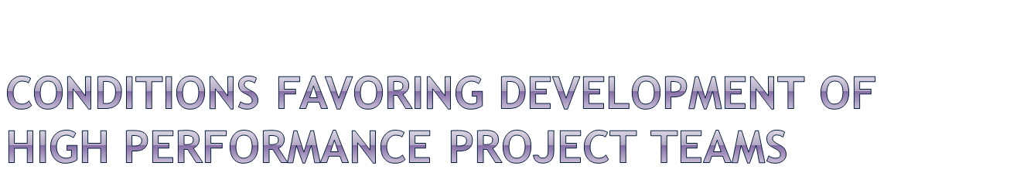
Ten or fewer team members
Voluntary team membership
Continuous service on the team
Full-time assignment to the team
An organization culture of cooperation and trust
Members report only to the project manager
All relevant functional areas are represented on the team
The project has a compelling objective
Members are in speaking distance of each other
11<number>

Slide 6

Forming: transition from individual to team member
  enthusiasm; anticipation; uncertainty; anxiety
Storming: try to figure out team environment
  discomfort; frustration; resistance; anger; tension
Norming: adjust and conform to team environment
  acceptance; cohesion; camaraderie; cooperation
Performing: team is now highly effective
  committed; eager; unity; satisfaction; pride; confidence; openness; interdependent; empowered
Adjourning: wrap-up, prepare to disband
  pride; sadness; uncertainty; “projectitis”
Part 3 - Project Teams & Conflict
Notes:
Camaraderie- mutual trust and friendship among people who spend a lot of time together.
Cohesion - the action or fact of forming a united whole.
“projectitis” occurs when the project team and the project manager develop a strong attachment to the project

Slide 7


Recruiting Project Members
  Factors affecting recruiting
    Importance of the project
    Management structure used to complete the project
  How to recruit?
    Ask for volunteers
11–<number>

Slide 8
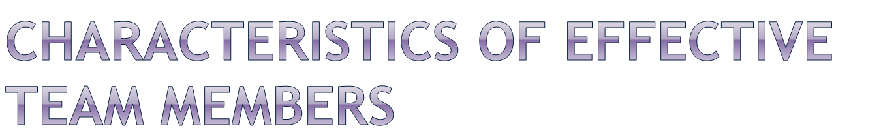
Technically competent
Good problem-solving abilities
Goal orientation
    Politically sensitive / Political connections
Credibility
Availability
Ambition, initiative, and energy
High self-esteem
Part 3 - Project Teams & Conflict
Notes:
Technical competencies describe the application of knowledge and skills needed to perform effectively in a specific job or group of jobs within the organization. These types of competencies are closely aligned with the knowledge and skills or “know-how” needed for successful performance
politically correct. (redirected from Politically Sensitive) Also found in: Dictionary, Thesaurus. Referring to language reflecting awareness and sensitivity to another person's physical, mental, cultural, or other disadvantages or deviations from a norm.
Organizations by their nature are political. The political process is always at work in organizations. To be effective, project managers need to become politically sensitive. Power is the ability to cause or prevent an action and make things happen. Since project management is all about getting results, it stands to reason that power is required.
The challenge is to create an environment for positive politics. That is, people operate with a win-win attitude. All actions are out in the open instead of hidden, below the table, or behind closed doors. People demonstratively work hard toward a common good.
Credibility - the quality of being trusted, being convincing and believed in.

Slide 9

Help create a positive and effective environment
Plan, control, and feel accountable for their work
Have high expectations of themselves
Manage their time well
Make things happen, not just let them happen
Are self-directed and follow through on actions
Take pride in doing quality work
Participate and communicate with the team
Provide constructive feedback to each other
Old saying: There’s no I in TEAM
Part 3 - Project Teams & Conflict

Slide 10

Encourage socializing among team members. Why?
Locate team member work areas close together. Why?
Periodically hold team meetings, as opposed to project meetings, to discuss ideas for the team to be more effective
Part 3 - Project Teams & Conflict
Notes:
he phrase “silo effect” might sound a little eerie at first, like the plot of a creepy sci-fi movie that takes place on a farm. But what is it, really?
The silo effect occurs when separate departments or teams within an organization don’t communicate effectively with each other – and productivity suffers because of it. One quintessential example of the silo effect is when two departments are working on practically identical initiatives, but neither of them is even aware of what the other is doing.
Despite the fact that employees are more technologically interconnected than ever before, the silo effect continues to be a problem in offices of all types.
eographical distances, physical spaces, managerial differences, security issues, among other things, are all reasons why office silos may develop. After all, different teams usually specialize in different areas – and that’s a good thing. A Jack of all trades is a master of none, right?
But too much segmentation hurts productivity, profitability, and inter-office cohesion. So although the silo effect causes problems for companies, getting rid of silos altogether is not the answer.
So, how can you foster cross-team collaboration while maintaining necessary job differentiation?

Slide 11

Project managers must delegate responsibilities, coordinate work, and supervise and motivate team members
Most people believe that a participative management style works best with project teams
This style give more empowerment to team members and allows them to be more self-directed
A participative style with team empowerment requires less supervision by the PM
Part 3 - Project Teams & Conflict
Notes:
Participative (or participatory) management, otherwise known as employee involvement or participative decision making, encourages the involvement of stakeholders at all levels of an organization in the analysis of problems, development of strategies, and implementation of solutions

Slide 12

Authority, responsibility, and accountability
The PM is responsible and accountable for project success.
Unfortunately, the PM often does not have authority over personnel or use of resources
This requires the PM to be creative and skillful at influencing and motivating others
Part 3 - Project Teams & Conflict

Slide 13

Must have credibility with the person
Common goals must be found
Use “vivid” language and compelling evidence
Must connect with the emotions of those they want to persuade
Part 3 - Project Teams & Conflict

Slide 14
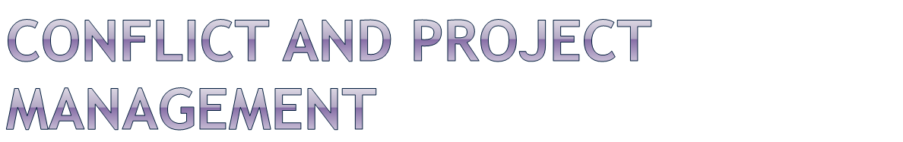
A battle, contest or opposing forces existing between primitive desires and moral, religious or ethical ideas
  (Webster’s Dictionary)
A state of incompatibility of ideas between two or more parties or individuals
Conflict management is the practice of identifying and handling conflict in a sensible, fair and efficient manner
Part 3 - Project Teams & Conflict

Slide 15
Conflict is inevitable; PM should expect conflict
PM can anticipate and avoid some conflicts; others must be managed and resolved
PM can learn different approaches for managing and resolving conflict; it’s a learned skill
Fast conflict resolution is key to project success
Part 3 - Project Teams & Conflict
Copyright 2004, Dr. Greg Frazier

Slide 16

Has anyone been part of a project conflict or had a conflict occur in their project recently?
Can you briefly describe the conflict and how it was resolved?
Part 3 - Project Teams & Conflict

Slide 17

The PM controls the project communication system
All parties should be kept updated about their areas of interest with the project
Email, phone calls, faxes, meetings, letters, and websites are all useful means of communication
By facilitating effective communication with stakeholders and participants, the PM can avoid many conflicts
Part 3 - Project Teams & Conflict

Slide 18

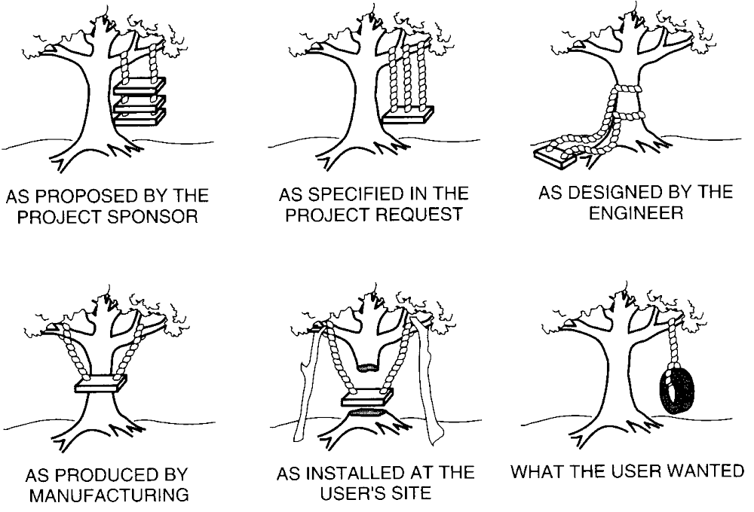
Part 3 - Project Teams & Conflict

Slide 19

Work scope
Resource assignments
Schedule
Costs
Technical opinions
Priorities of resource time
Administrative procedures
Responsibilities
Personality clashes
Part 3 - Project Teams & Conflict
Notes:
The most common causes of conflict within groups are:
• Faulty communication : criticism is given inappropriately, and group members’ feelings
are hurt and they feel devalued
• Attribution errors: members make errors in determining the causes of the behaviour of
other members. This can occur, for example, when one member doesn’t complete his or
her work and the other members jump to the conclusion that the reason for this was
nothing more than irresponsibility. Maybe there was a good reason why that one member
fell behind.
• Mistrust: members do not trust each other due to poor communication, faulty
attributions, or someone’s lack of follow through on obligations
•Grudges: members hold grudges when they feel they have been treated unfairly, when
criticism has been given inappropriately, when there have been faulty attributions, or for
other reasons; people become angry with each other and they sometimes nurse their anger
and remain hostile rather than working through and resolving their anger and moving on.
•Personality clashes:
this can occur when groups are put together randomly in particular.
The styles of working differ with each member and in some cases, there may be a lack of
fit among the members” (Hadad & Reed, p. 267).

Slide 20

Scope creep refers to the work scope being enlarged as the project progresses
Scope creep can cause conflicts due to insufficient resources or time to do the additional work
PM should be cautious about scope creep
A change control system can be helpful
Part 3 - Project Teams & Conflict

Slide 21

Client wants a different feature or additional functionality
Project team comes up with a way to improve the project outcomes
Senior management wants the project to do something extra
Engineering enhances a design component
A new technology becomes available
A new government regulation is mandated
Part 3 - Project Teams & Conflict

Slide 22

The PM has final responsibility to resolve or manage any conflict that affects project success.
The PM should focus on identifying the root cause of the conflict and not the symptoms, so the conflict will not recur.
For example, suppose two people are yelling at each other during a meeting. Asking them to not yell fixes the symptom, but not the root cause of the conflict, which may be a difference of opinion about an issue due to different assumptions being made by each person.
Part 3 - Project Teams & Conflict

Slide 23

Facts: People see the same fact from distinctly different viewpoints
Methods: People disagree on how to do something
Goals: The goals toward which people work are different
Values: People differ in their basic values
Part 3 - Project Teams & Conflict

Slide 24

Encourage Functional Conflict
sharing different opinions or points of view
debating two sides of an issue
playing the devil’s advocate
all sides should show mutual respect
Resolve Dysfunctional Conflict
may create negative tension for all team members
may lead to irrational personality clashes
situation may get worse and result in project delay
resolve as soon as possible
Part 3 - Project Teams & Conflict

Slide 25
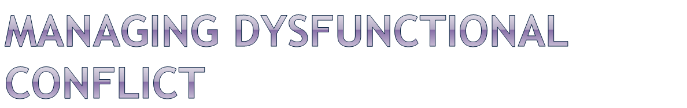
5 Alternative Approaches to Managing Conflict:
Mediate the conflict – negotiate a solution
  emphasize urgency for the sake of project success
Arbitrate the conflict – impose a solution
  do what is best for project success
  try to allow both sides to save face
Control the conflict – reduce tensions; How?
Accept it – sometimes, learn to work around it
Eliminate the conflict – if no longer tolerable
  remove one or both members from team
Part 3 - Project Teams & Conflict
Notes:
Two types of conflict that can occur within a company are functional and dysfunctional.
Functional conflict is healthy, constructive disagreement between groups or individuals, while dysfunctional conflict is unhealthy disagreement that occurs between groups or individuals.
Arbitration and Mediation Law and Legal Definition. Arbitration is an alternative means of setttling a dispute by impartial persons without proceeding to a court trial. It is sometimes preferred as a means of settling a matter in ordert to avoid the expense, delay, and acrimony of litigation.

Slide 26

Avoiding – not raising or addressing the conflict issue
Accommodating – seeking to satisfy the other person’s concerns at the expense of your own
Competing – using whatever seems appropriate to win your own position
Collaborating – working with the other person to find a solution that fully satisfies both your own concerns and those of the other person
Compromising – seeking a middle-ground position that provides partial satisfaction for both parties
Part 3 - Project Teams & Conflict

Slide 27

The PM must frequently negotiate on different issues with different parties
Negotiating is an art, and you get better with practice
It’s better if both parties feel good about the negotiation experience after it’s over. Why?
Good interpersonal skills can be helpful in making the other party feel okay with the results, even if they are not just what they wanted
Part 3 - Project Teams & Conflict

Slide 28

Separate the people from the problem
Focus on interests, not positions
Before trying to reach agreement, invent options for mutual gain
Use objective criteria when possible
The key to finding a negotiator’s interests and concerns is to ask “Why?” when they state a position
Part 3 - Project Teams & Conflict

Slide 29

Has anyone had to negotiate on a project issue recently?
Can you briefly describe the negotiation process and results?
Part 3 - Project Teams & Conflict

